Slide 1
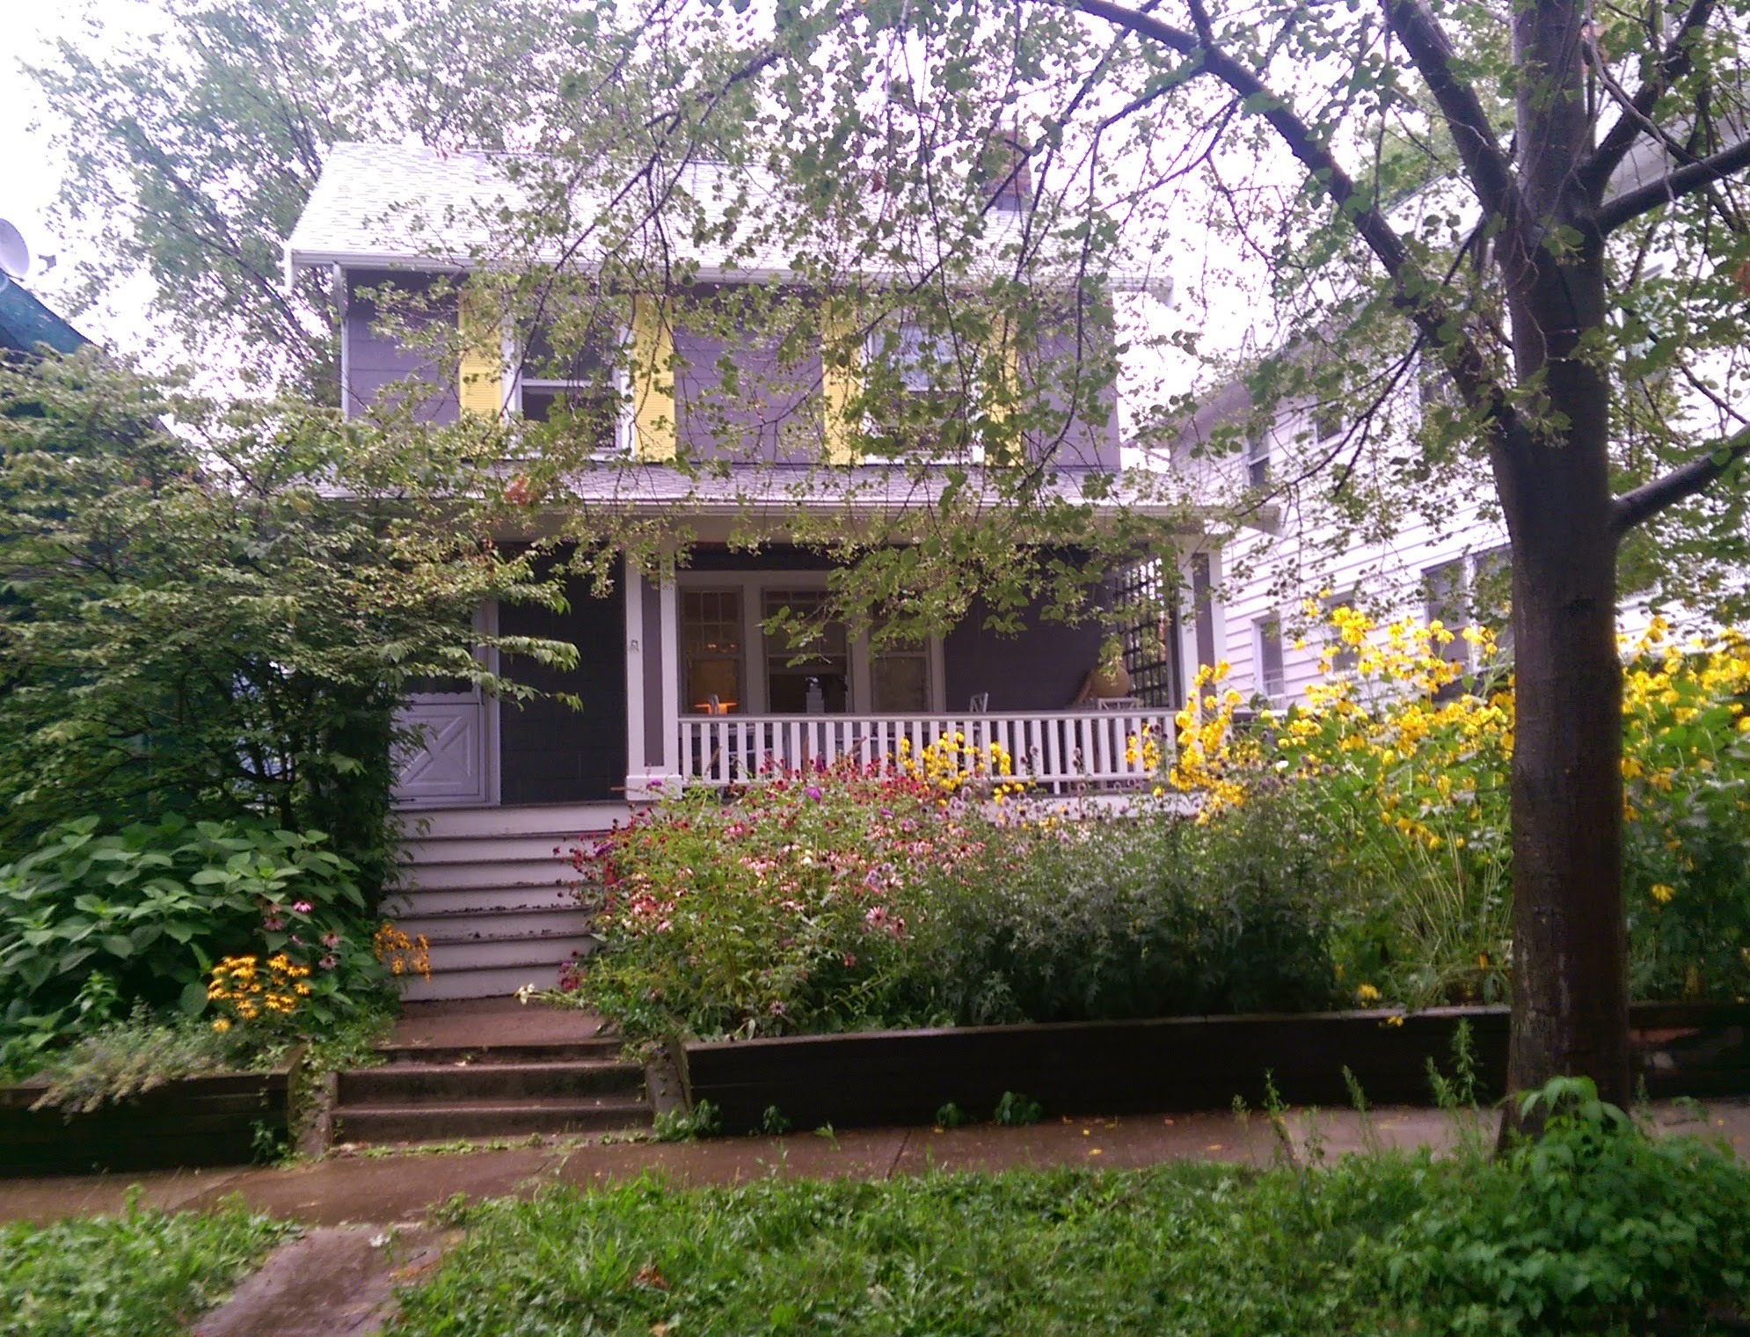


Smart Landscaping
For Clean Water
Jared Bartley
Senior Program Manager
Notes:
Give Overview

Slide 2
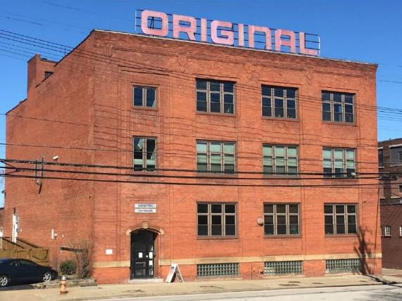
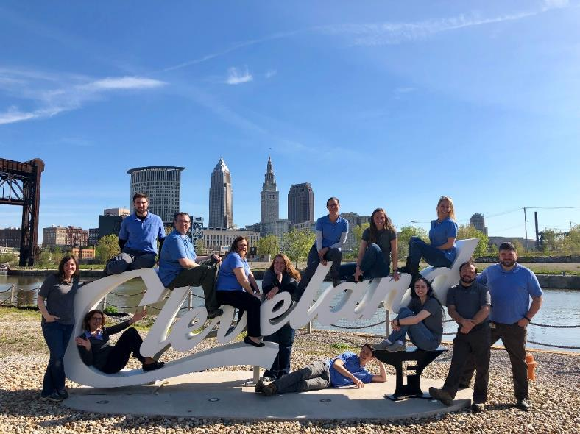
Mission
Mission:
Implement programs and practices that protect and restore healthy soil and water resources.
Notes:
*1949 first county agency focused on conservation & natural resource protection

Slide 3
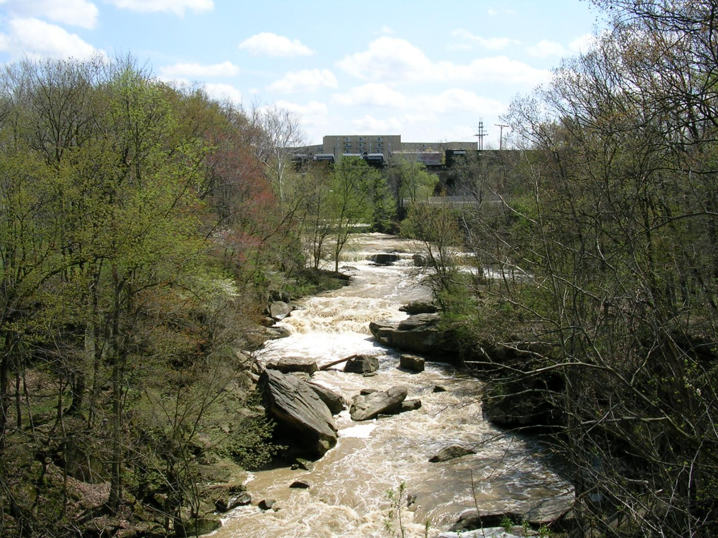
What is a Watershed?
A watershed is simply the land that water flows across or under on its way to a stream, river, or lake. Our landscape is made up of many inter-connected basins or watersheds. Within each watershed, all water runs to the lowest point - a stream, river, or lake. On its way, water travels over the surface and across farm fields, forest land, suburban lawns, and city streets, or it seeps into the soil and travels as ground water.

Slide 4
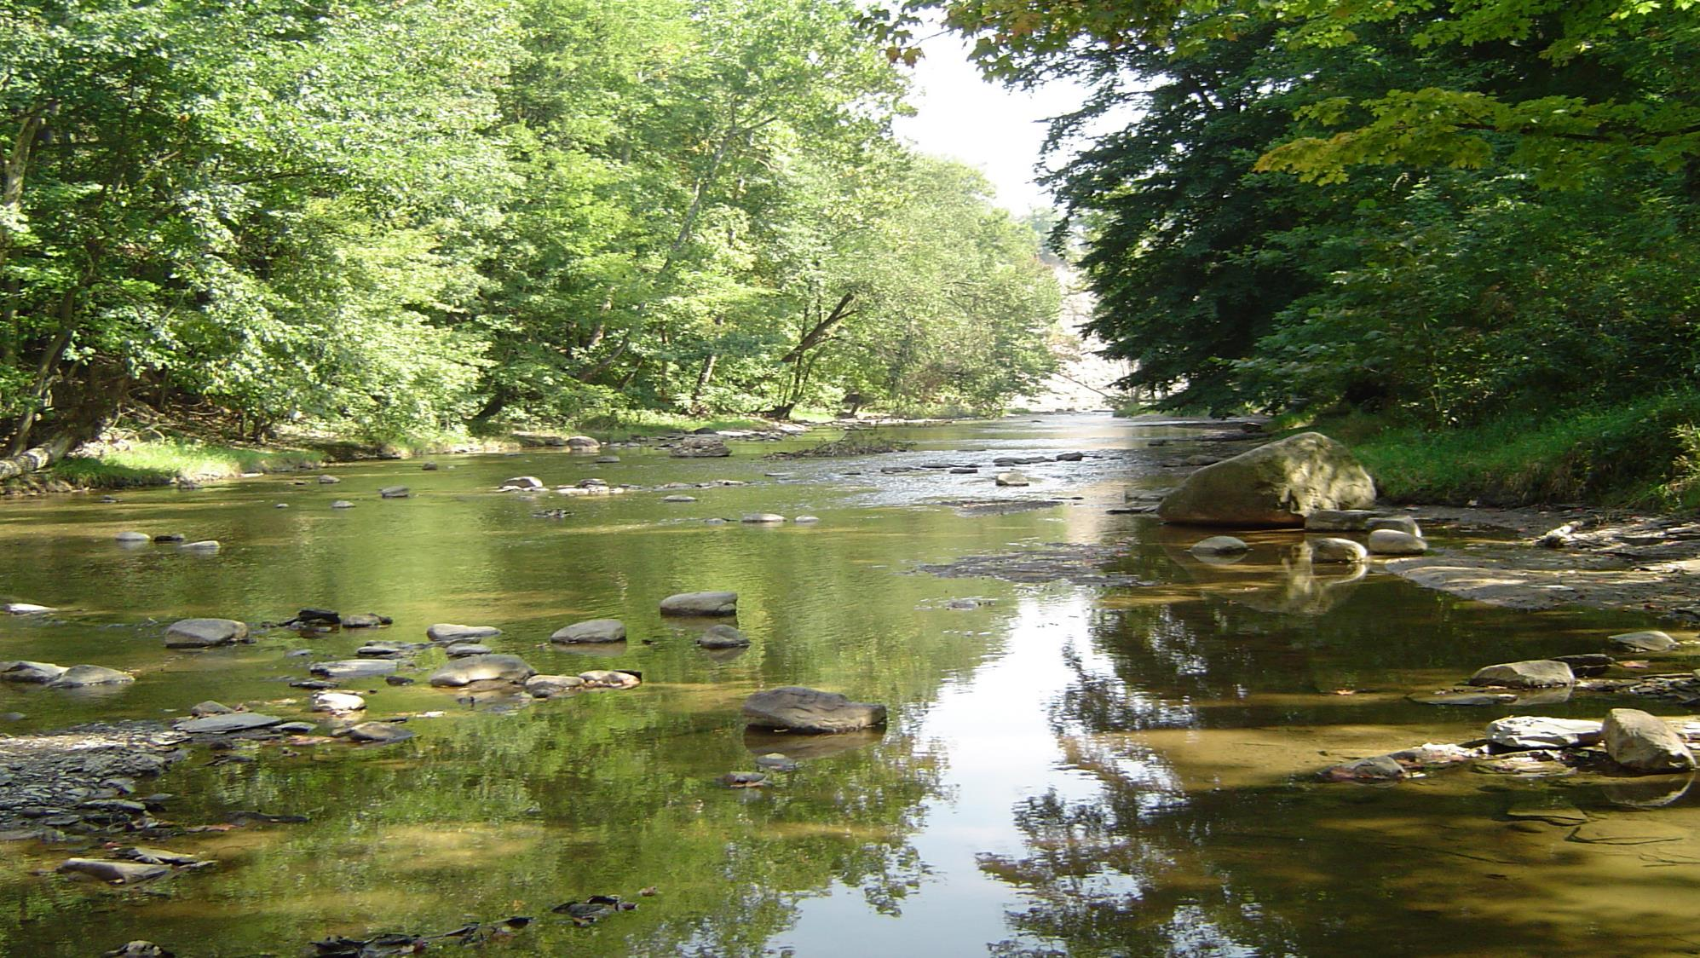

Rocky River Watershed Council
The mission of the Rocky River Watershed Council is to protect, restore, and perpetuate a healthy watershed through public education, watershed planning, communication, and cooperation among stakeholders.

Slide 5
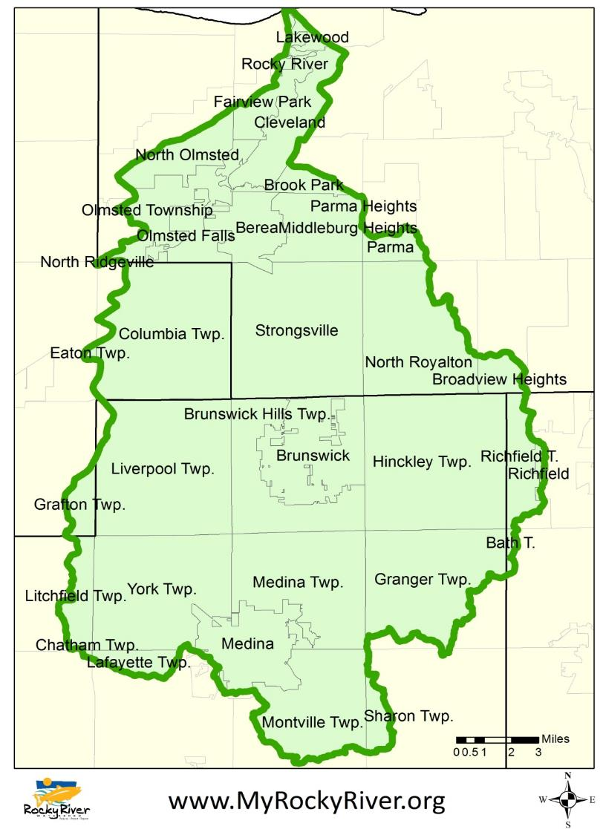
The Rocky River Watershed
664 miles of stream
294 square miles
All or part of 32 municipalities and townships in 4 counties
Population of ~250,000
Land Cover:
  42% wooded
  40% agricultural
  14% urban
  1% non-forested wetlands

Slide 6
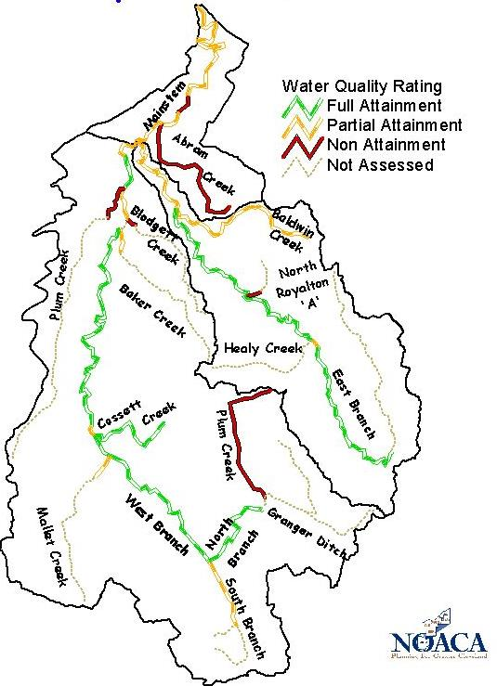
Major Impairments
Habitat Degradation
Sediment
Nutrients
Bacteria
Causes
(Sub)Urbanization
Loss of Floodplain Function
Underperforming Waste Treatment
Ag Practices
Apathy

Slide 7
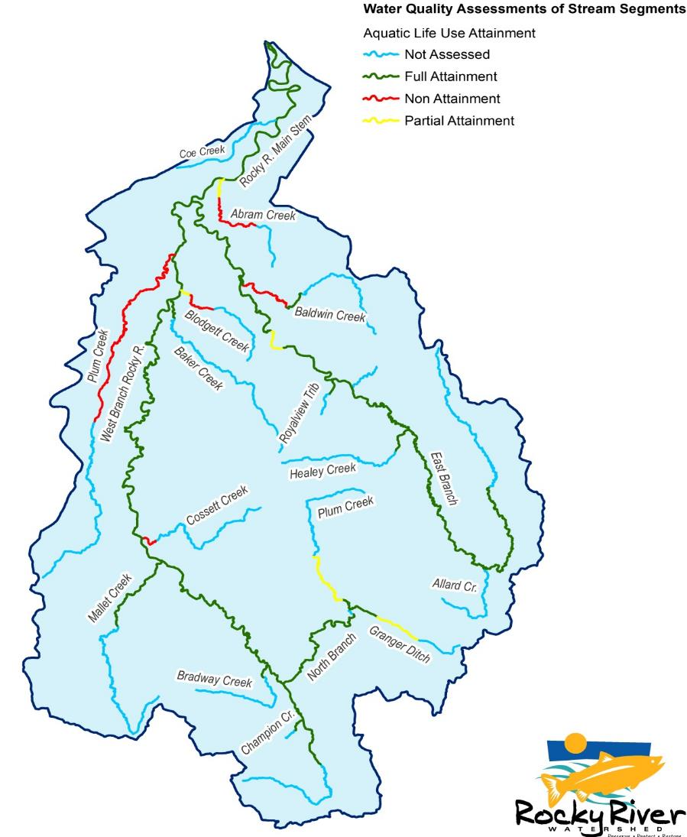
Major Impairments
Habitat Degradation
Sediment
Nutrients
Bacteria
Causes
(Sub)Urbanization
Loss of Floodplain Function
Underperforming Waste Treatment
Ag Practices
Apathy

Slide 8
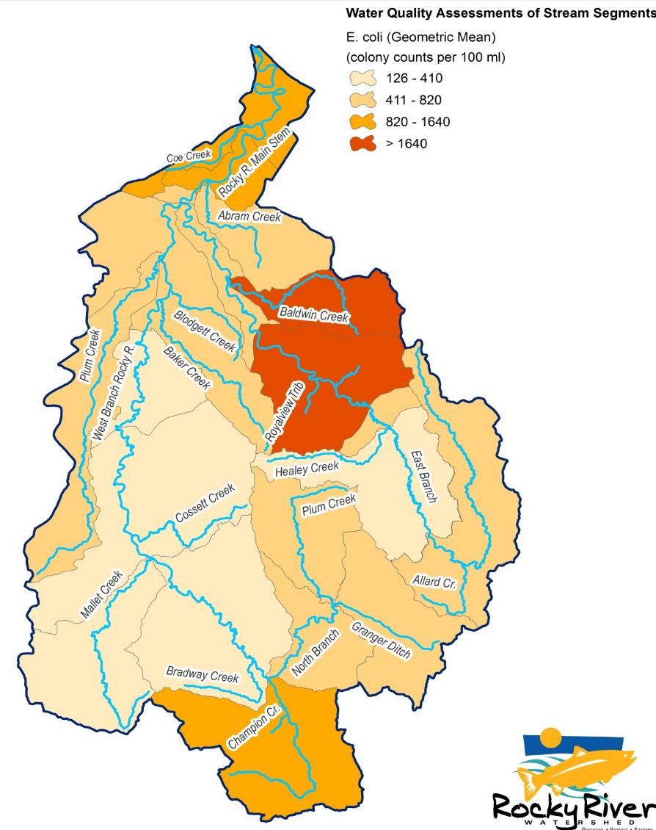
Major Impairments
Habitat Degradation
Sediment
Nutrients
Bacteria
Causes
(Sub)Urbanization
Loss of Floodplain Function
Underperforming Waste Treatment
Ag Practices
Apathy

Slide 9
http://cawalup.usc.edu:3455/cawalup/Home

Slide 10
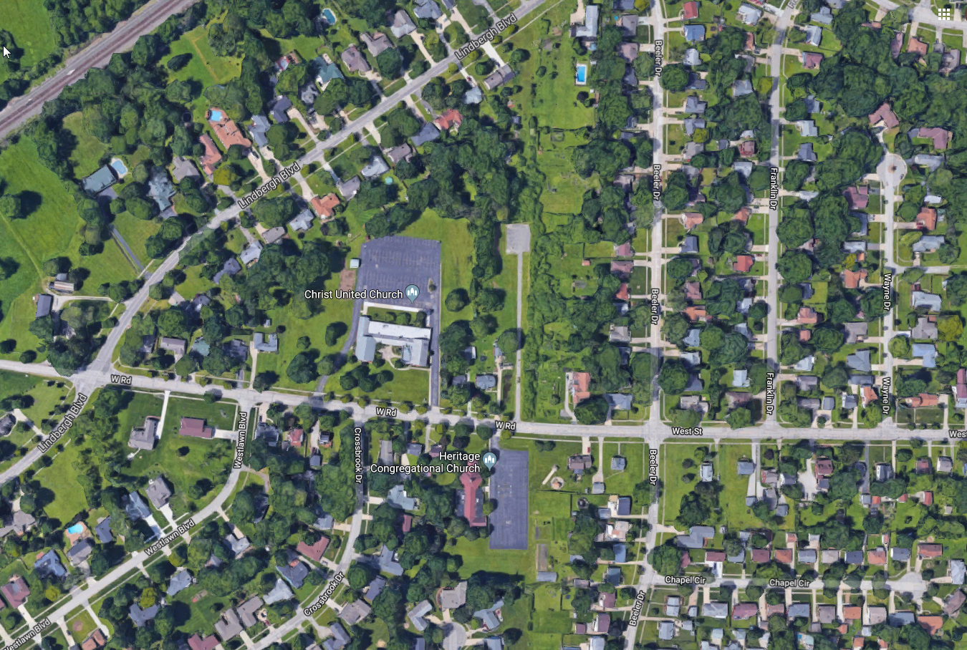

Slide 11
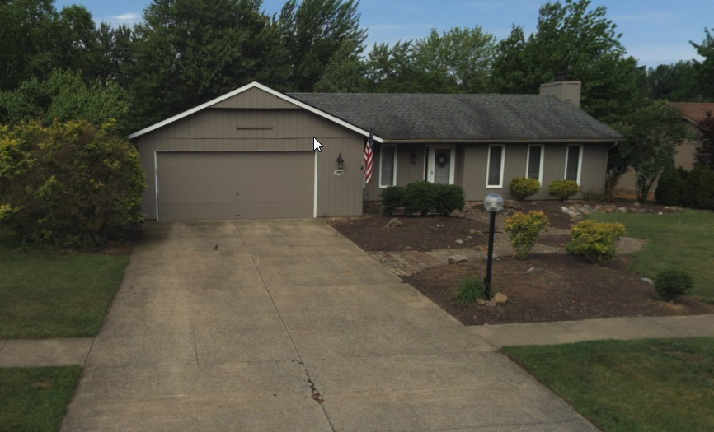
What’s Your Runoff Footprint???
House Area: Length X Width = __ sqr ft
40 ft X 25 ft. = 1000 sqr ft
For a 0.1” rain event, multiply
House Area X 0.052 = RUNOFF (gallons)
1000 sqr ft X 0.052 = 52 gal
For a .25” rain event, multiply
House Area X 0.13 = RUNOFF (gallons)
1000 sqr ft X 0.13 = 130 gal

Slide 13
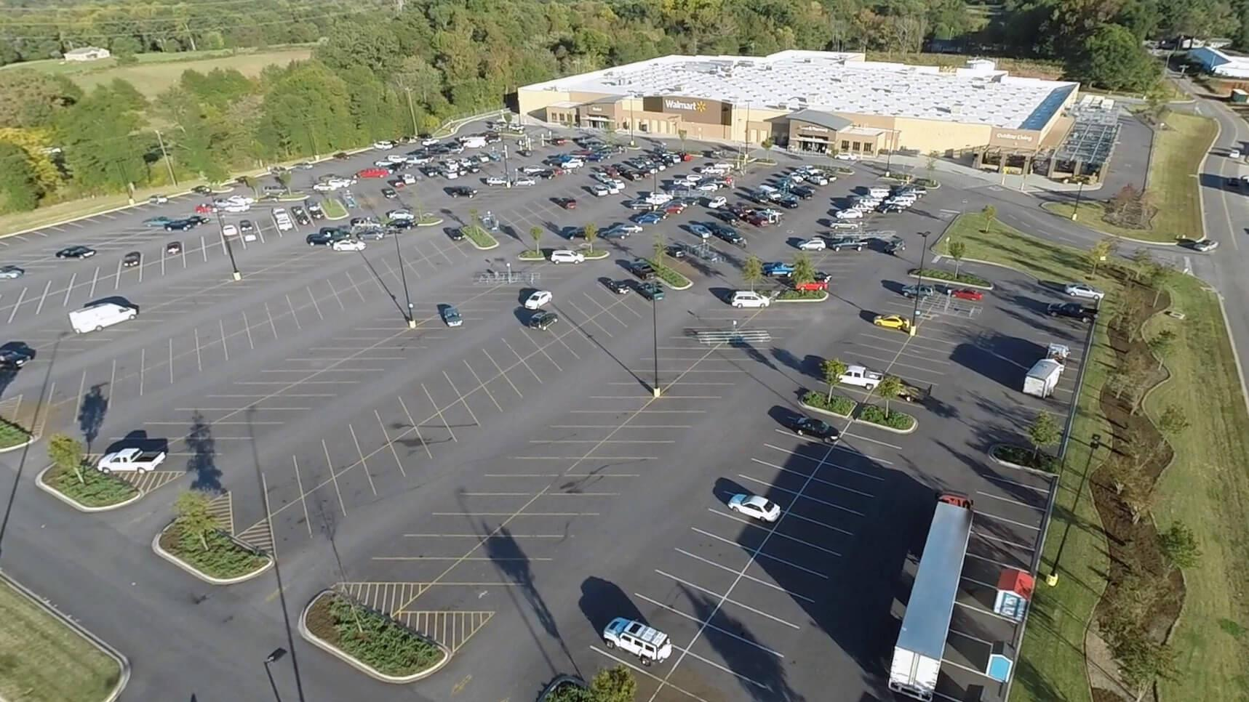

Slide 14
How to Reduce
Your (Negative) Impact
Reduce Runoff Volume
Reduce Pollution in Runoff
MAXIMUM IMPACT!

Slide 15
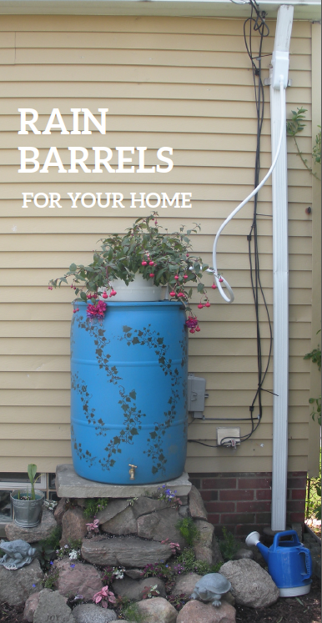
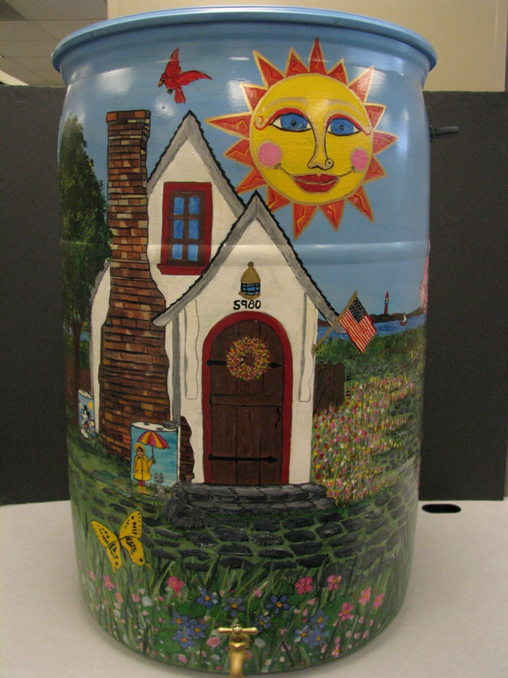

Slide 16
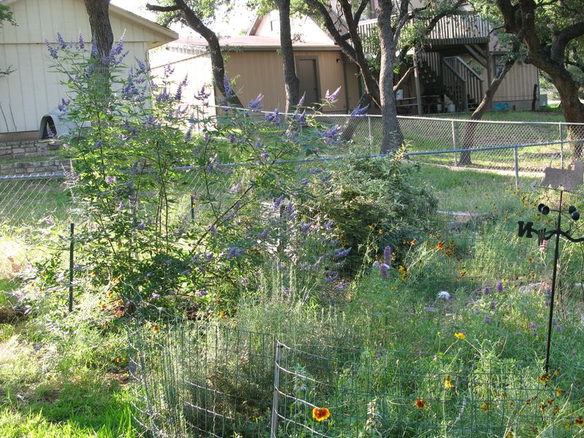
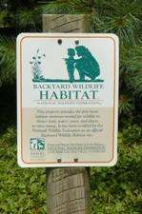
Shrink Your Lawn:
Make A Space for Nature
Set a goal to leave 10% of your lawn “Natural.”
Edges and next to creeks or ponds are easy spots.
Consider Native Plants, Wildflowers, etc.
Great for Butterflies and other pollinators.

Slide 17
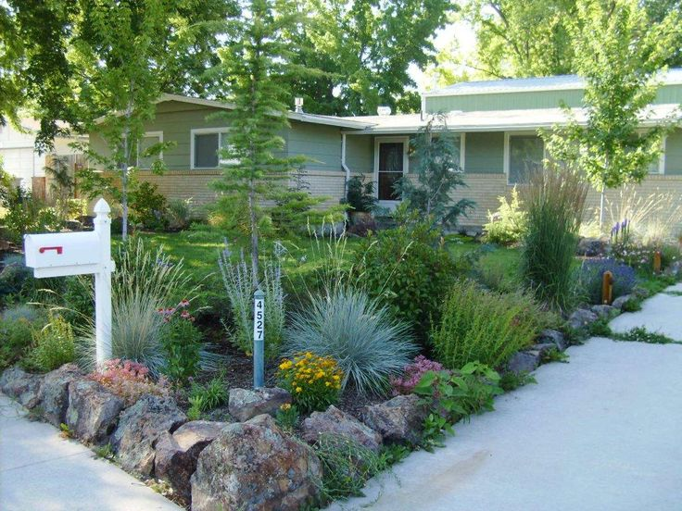

Cut Corners
Complement not
compete with
your lawn

Slide 18
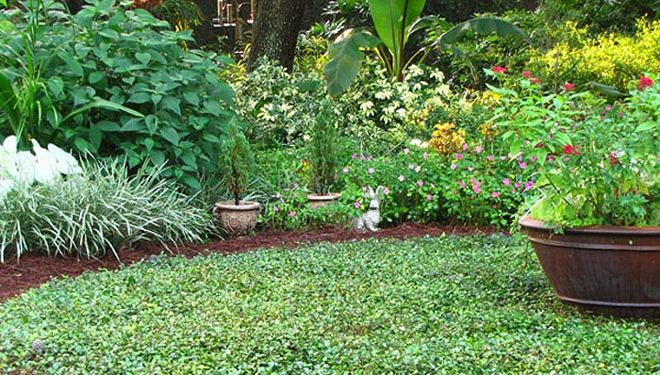
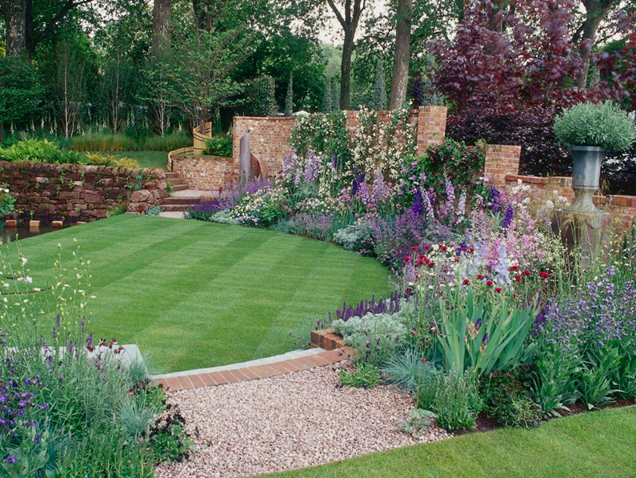
Hedge the Edge
Enhance the least used
area of your lawn.
Adds beauty and privacy.

Slide 19
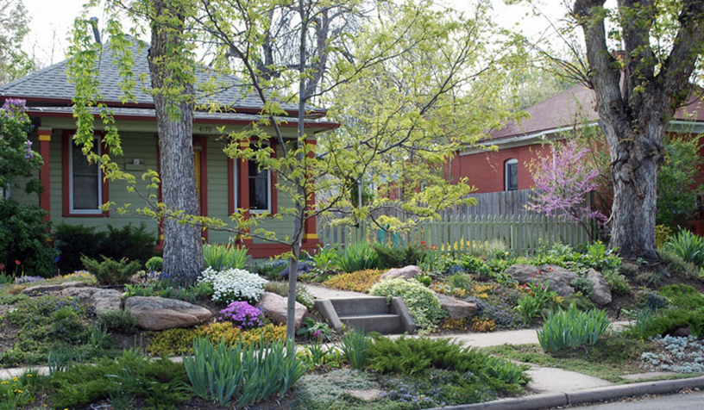
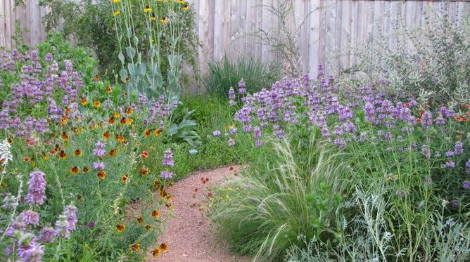
Go Wild!!
Self sustaining,
natural ecosystem

Slide 20
Homeowners Associations
….and just some good advice in general**
Know the rules
Plan to present your design at a board meeting for approval
**Be neighborly
**Start slow and smart
**Group plants
**Pay attention to height
**Let the garden sit for a few years before expanding it
“How to Design an HOA-Approved Pollinator Garden” www.houzz.com

Slide 21
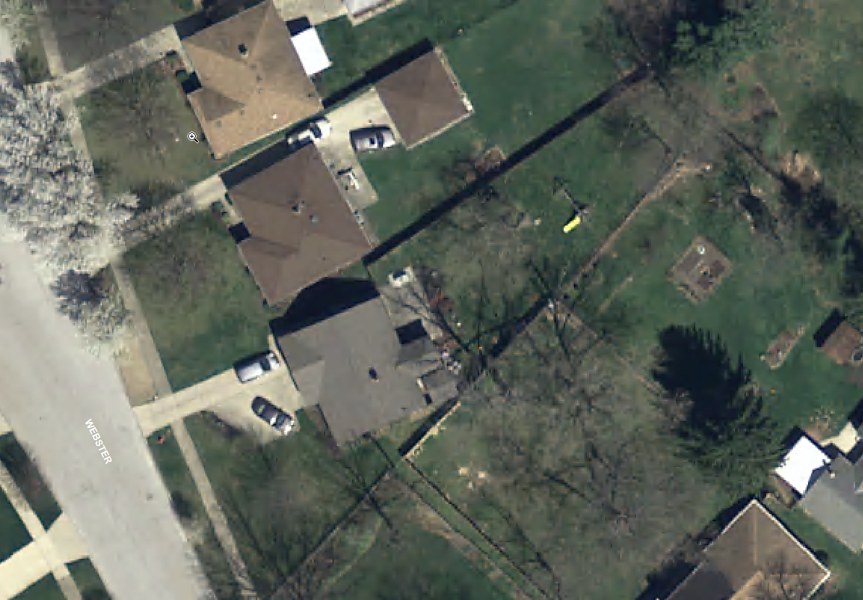
Shrink Your Lawn:
Make A Space for Nature

Slide 22
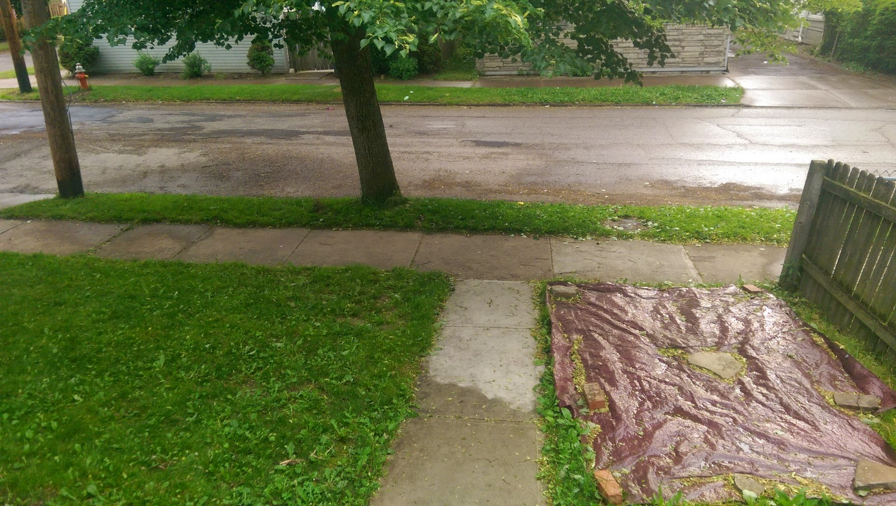

Slide 23
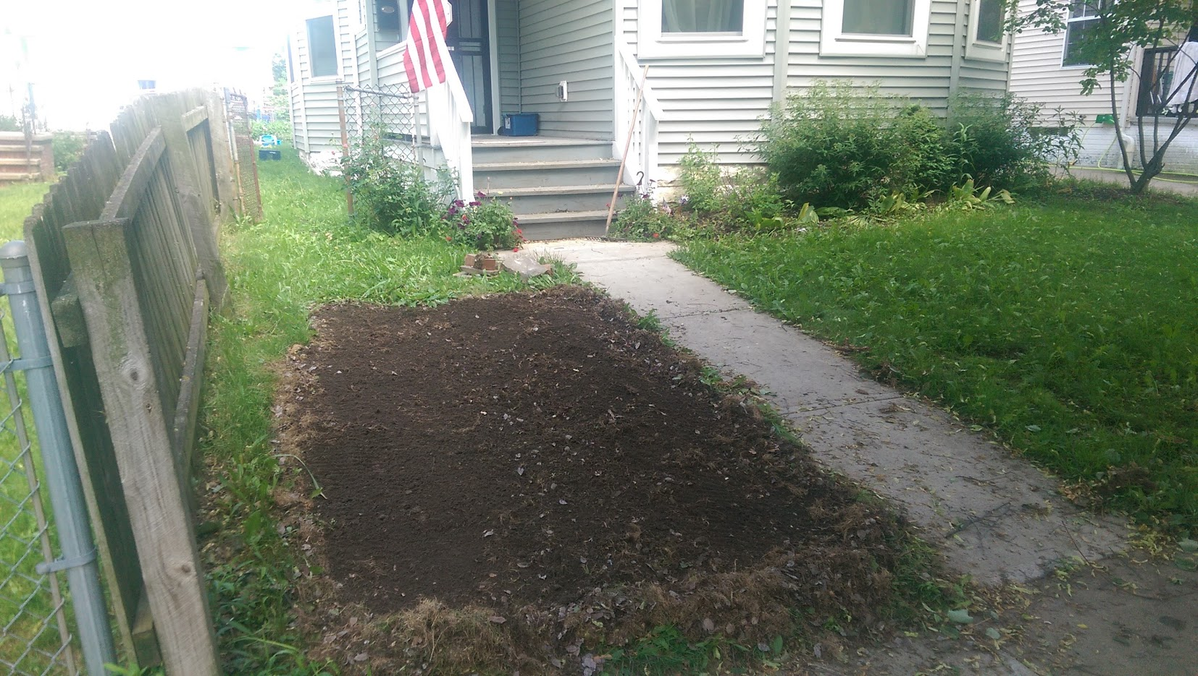

Slide 24
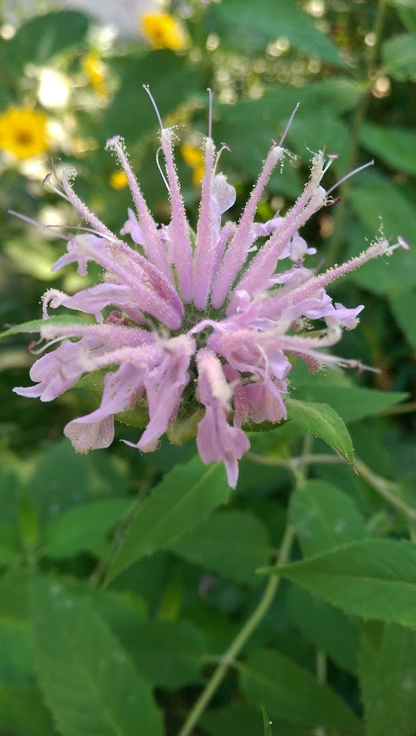
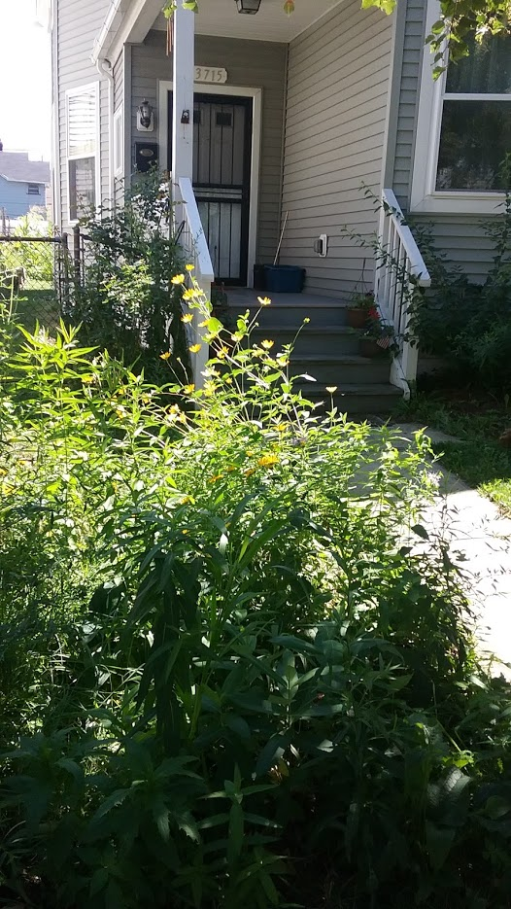

Slide 25
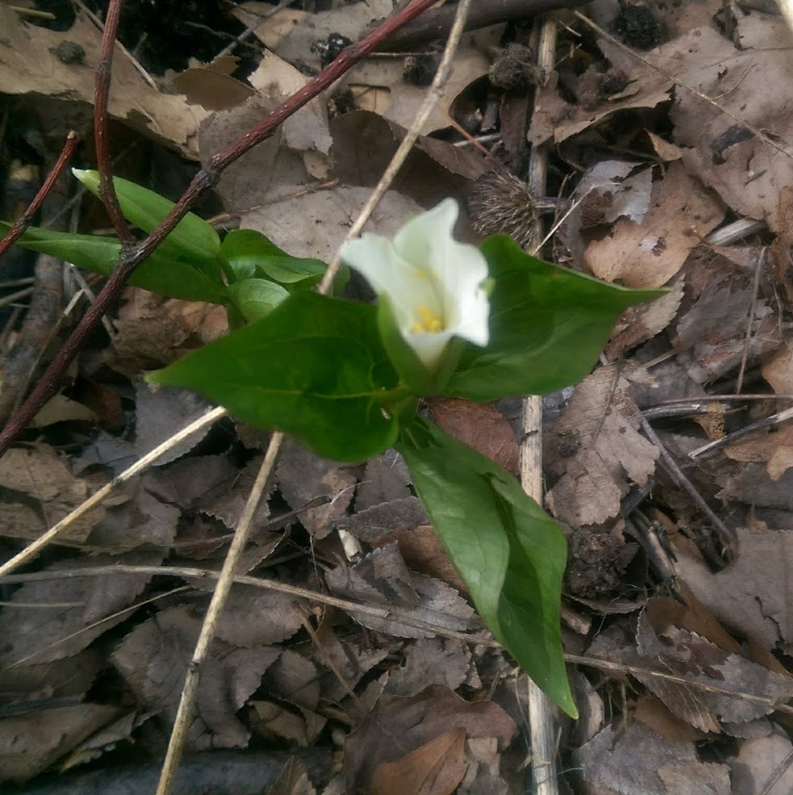

Slide 26
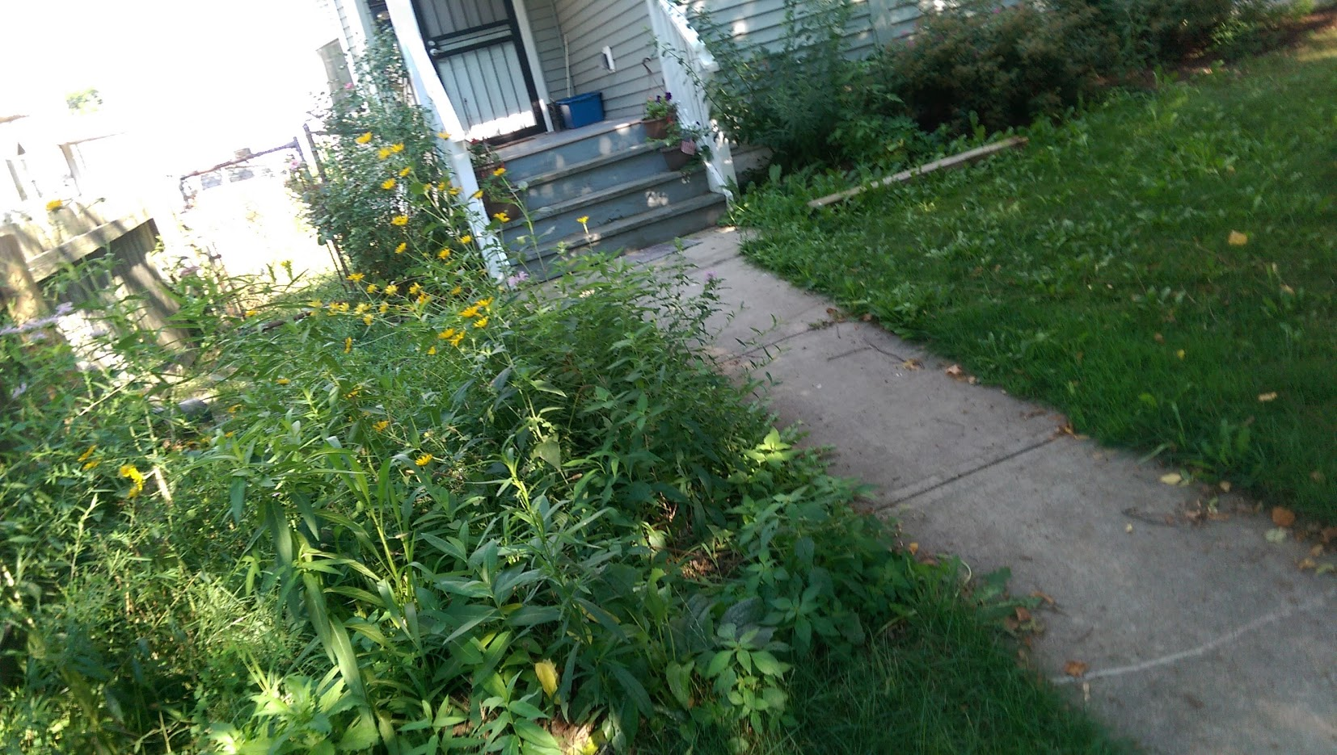

Slide 27
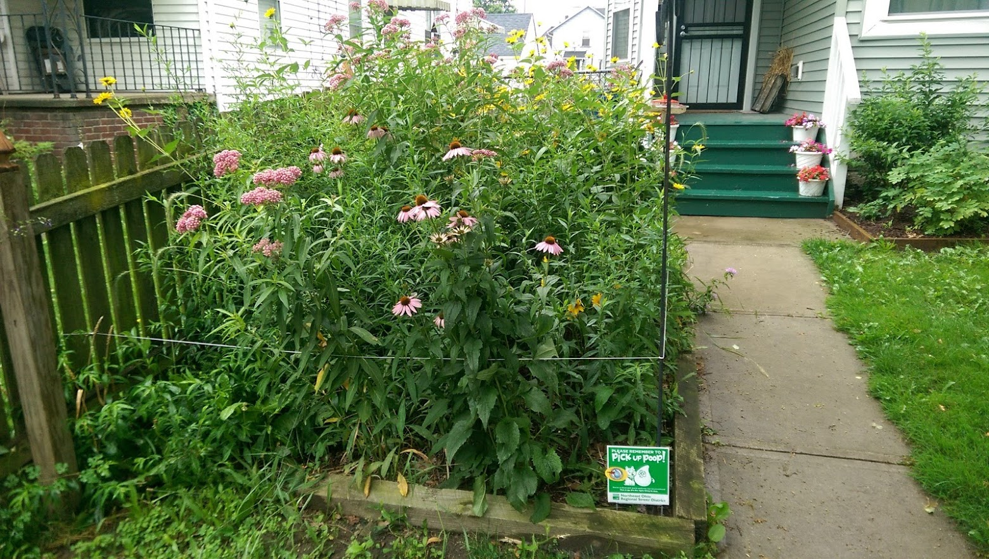

Slide 28
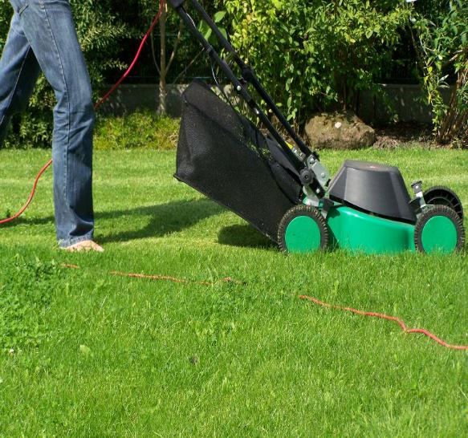
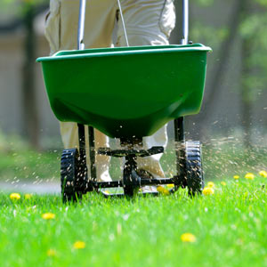

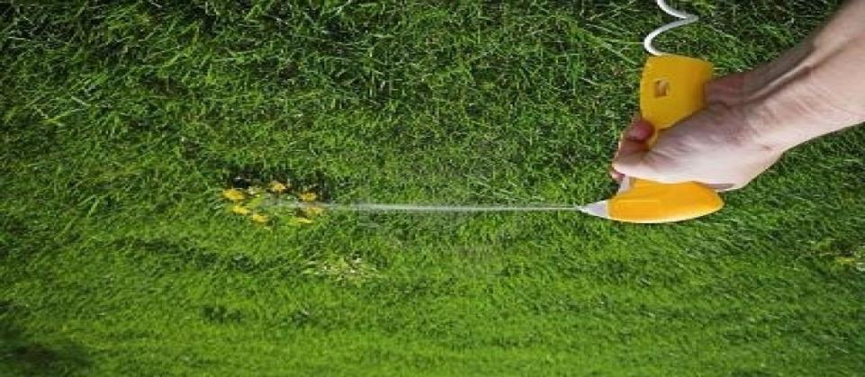
The Chemical-infused
Lawn Care Cycle
Mow to control growth of desired plants.
Fertilize to stimulate plant growth.
BREAK THE CYCLE!!!
Don’t forget to kill any insects that might wander through!
Spray to eliminate unwanted plants.

Slide 29
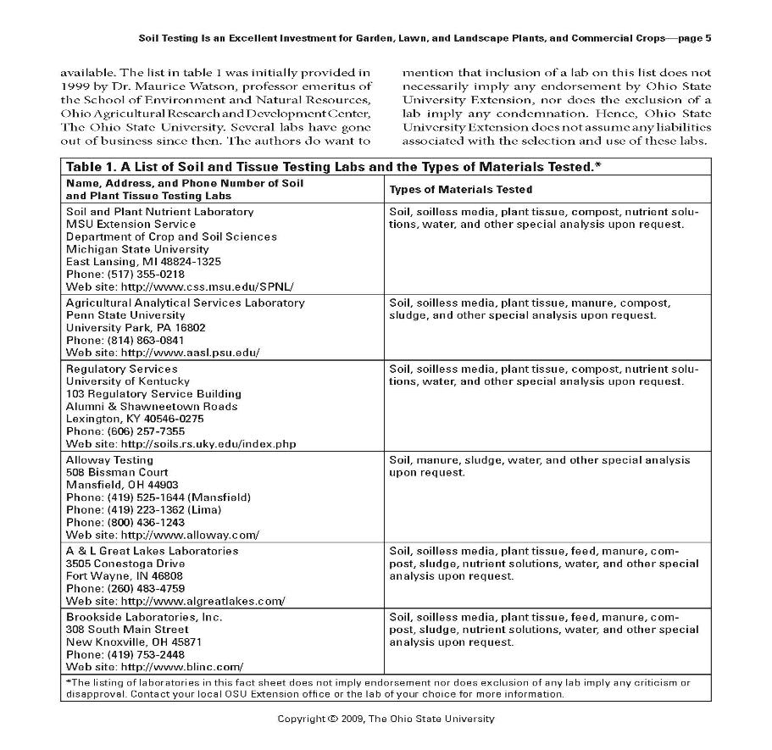


Break the Cycle: Fertilizers
First and foremost,
Get Your Soil Tested!
If you must fertilize, remember the 4 R’s:
Right Fertilizer
  Right Rate/Amount
  Right Time
  Right Place

Slide 30
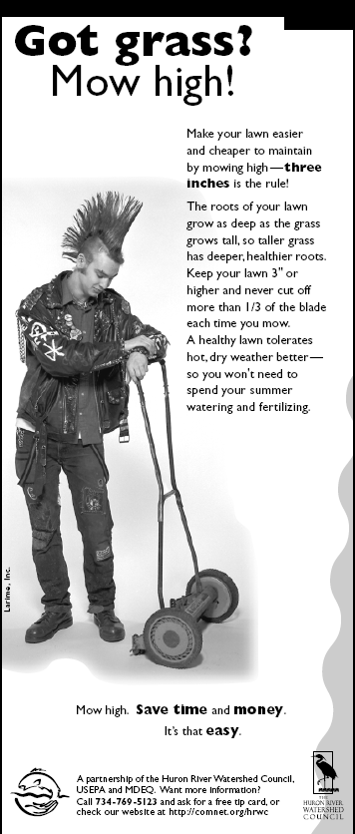
Break the Cycle: Mowing -
“Mow High and Let it Lie”
  Mow your grass no shorter than 3” tall
  Leave your grass clippings – this is great fertilizer for your lawn!!!
  Following these tips will reduce the need to water and fertilize your lawn

Slide 31
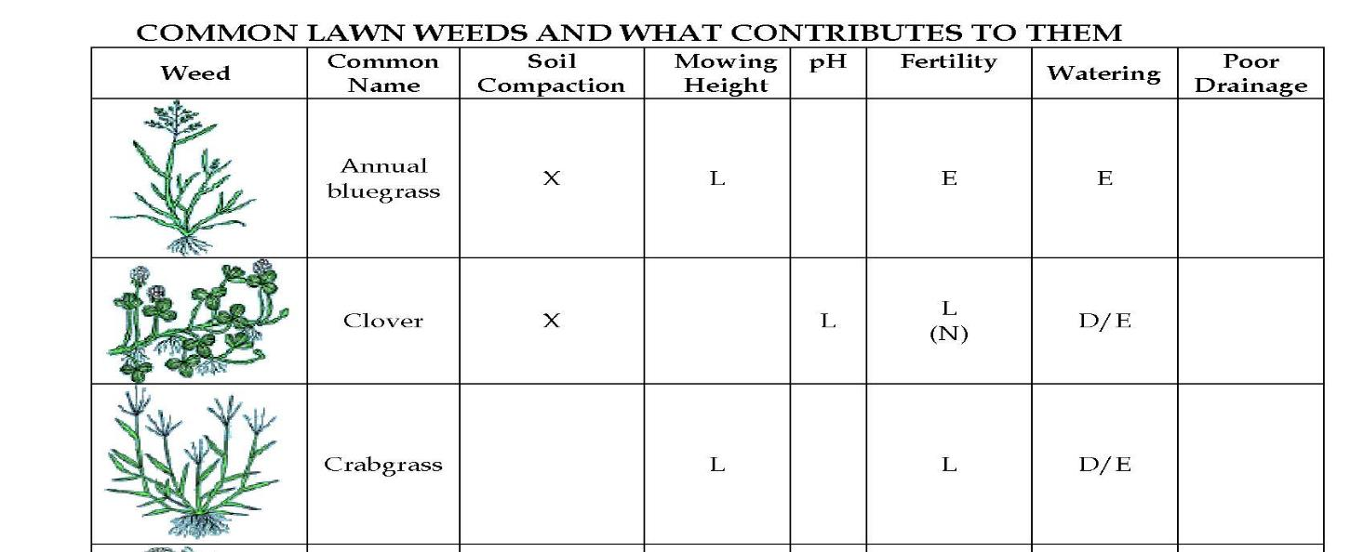
Break the Cycle:
Herbicides & Pesticides
Reconsider your definition of a weed, or your tolerance for them. Lawns don’t need to be monocultures!
“Read your Weeds” – National Coalition for Pesticide-free Lawns
**Handout

Slide 32
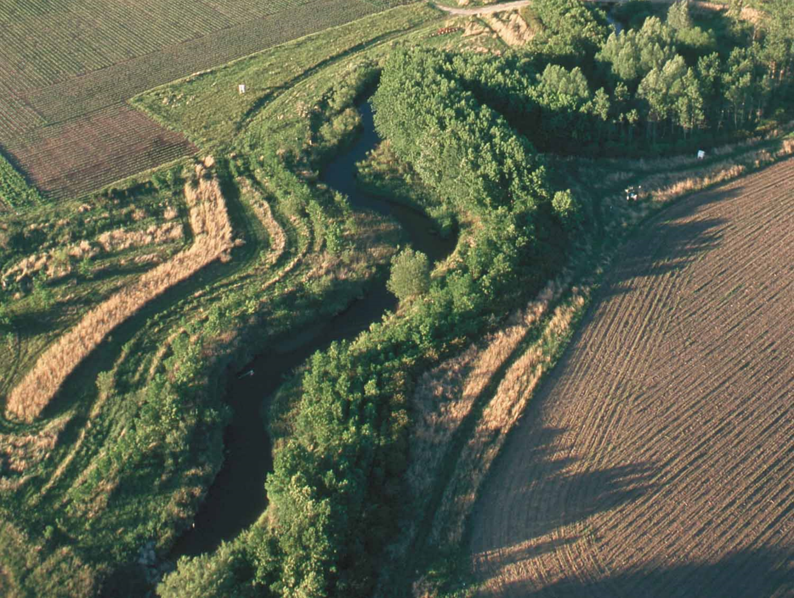
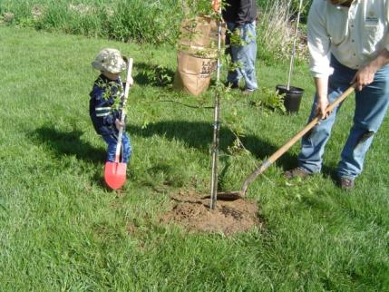
Vegetated Buffer Zones
Increase/maintain bank stability
Provide habitat
Trap sediment
Filter/cycle nutrients
Protect the stream from human activities
Protect property from the stream

Slide 33
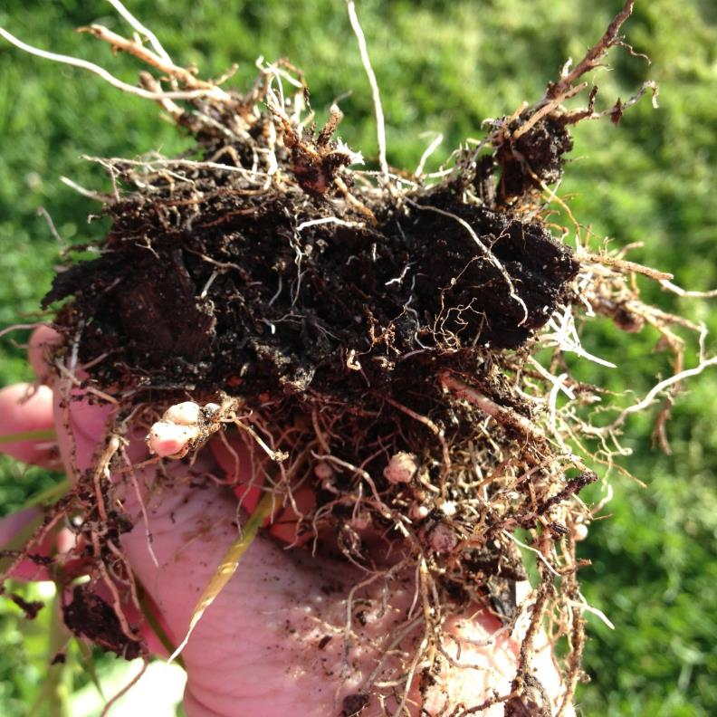
JUST SAY NO to
Conventional Garden Techniques
  Spring and/or Fall Tilling
  Loss of aggregation and collapse of pore structure, burns up organic material, reduces water capacity.
  Removal of Plant Debris
  Removes food/carbon from soil critters, pulling disrupts structure
  Soil naked over Winter
  Promotes weed growth, erosion, starves micro and macroorganisms, leaching of nutrients.

Slide 34

Be a CHAMPION for the Rocky River
Watershed
Do 3 or more ACTIONS to PROTECT and RESTORE the Rocky River.
Earn a SIGN for your yard to show your support!

Slide 35
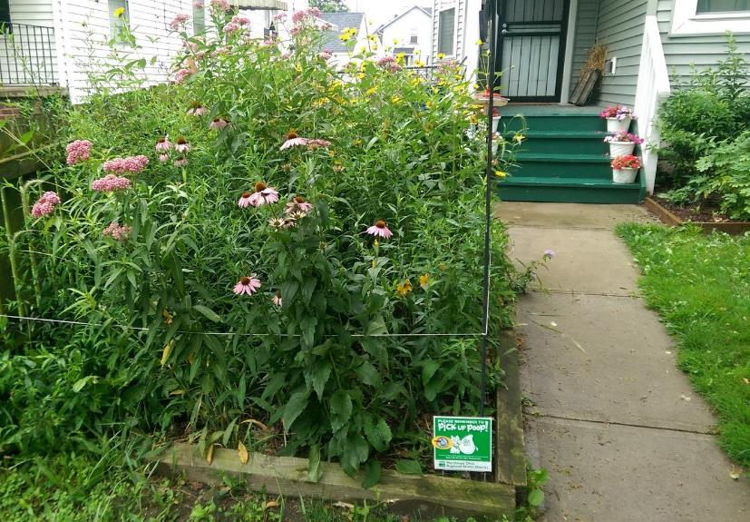
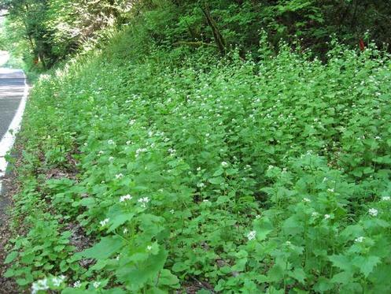
YOUR YARD
SHRINK your lawn- use native plants, shrubs and trees instead!
REMOVE non-native, invasive shrubs and plants!
REPLACE NON-NATIVES SHRUBS and flowers with natives to provide food and habitat for wildlife.
LEAVE your leaves: compost, mulch, or use in garden beds
SAVE WATER by not watering your lawn and collecting rainwater for your garden.
INSPECT and MAINTAIN your septic system regularly.

Slide 36
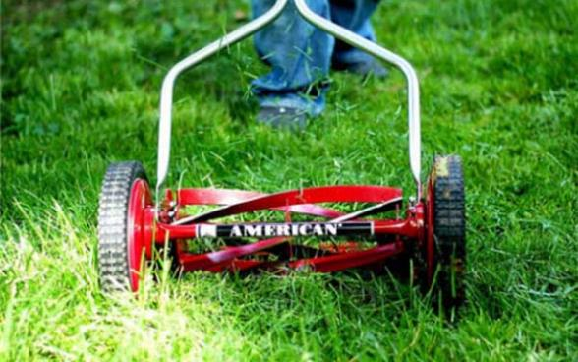
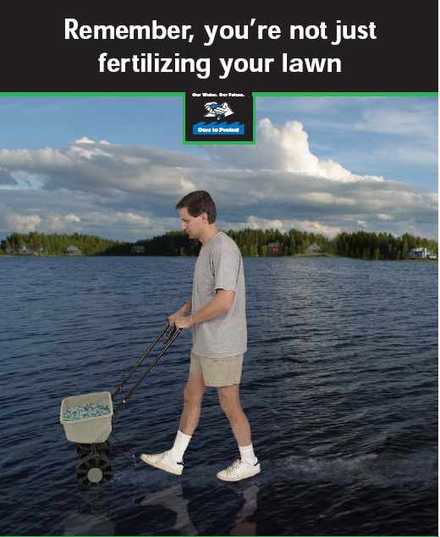
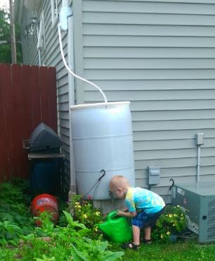
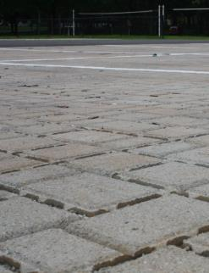
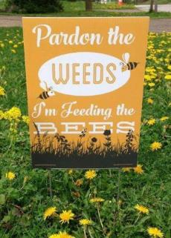
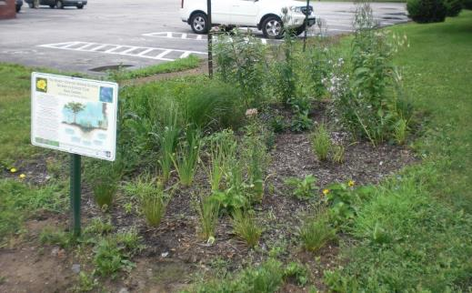
YOUR YARD
REDUCE POLLUTION of Air and Noise by mowing with non-gasoline powered tools.
KEEP CHEMICALS OUT of our waterway-
Wash your car on the lawn or at the car wash
Only fertilize after a soil test- and use organic fertilizers when you must
Spot treat with pesticides only when a problem is found.
SLOW DOWN STORMWATER with a Rain Garden or Rain Barrels, or permeable driveways.

Slide 37
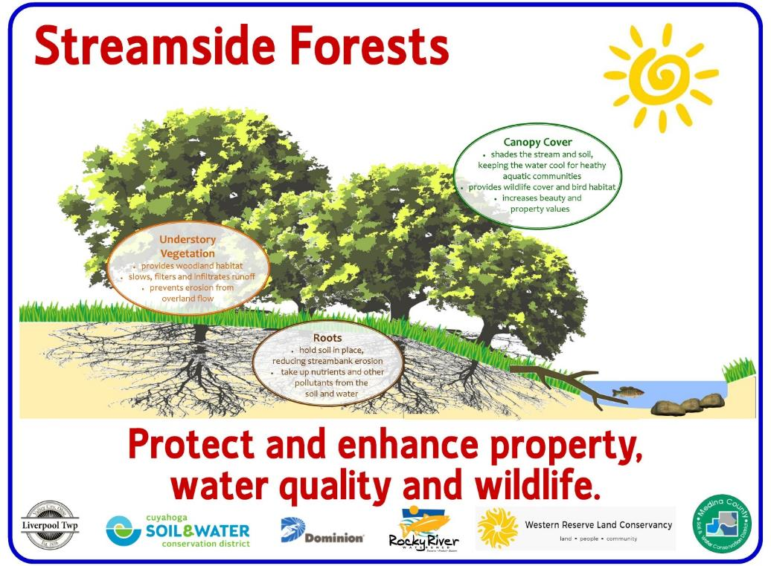
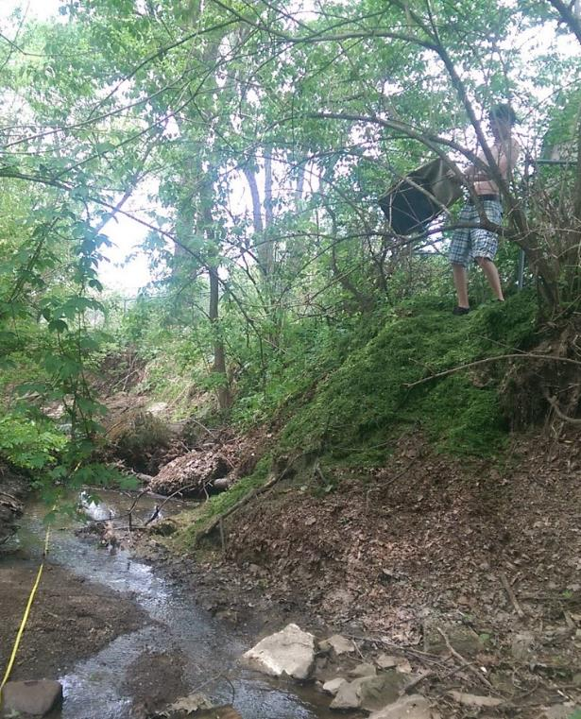
ALONG YOUR BACKYARD STREAM
LEAVE A BUFFER of vegetation along your stream- don’t mow to the edge of the waterway.
COVER EDGES and BARE BANKS with native groundcovers, shrubs, trees, and flowers.
KEEP CLIPPINGS OUT of the stream- never dump grass or leaves in the Rocky or any stream.

Slide 38
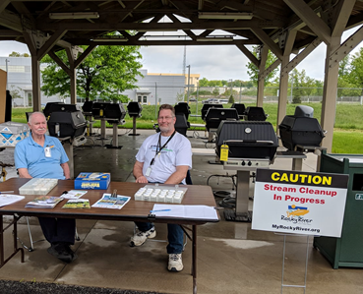
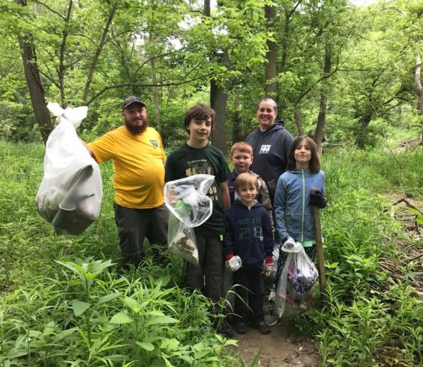

YOUR COMMUNITY
Tell your neighbors what you are doing for the ROCKY!
Display your RRWC CHAMPION SIGN proudly!
Tell your CITY or TOWNSHIP HALL what you are doing as a CHAMPION.
LOBBY your Town or Home Owners Association to use better practices.
VOLUNTEER at RRWC stream clean-ups and other activities!
Become a MEMBER of Rocky River Watershed Council!

Slide 39



Send completed form to Rocky River Watershed Council by emailing a photo or scan of your form to jbartley@cuyahogaswcd.org or by mail to:
Rocky River Watershed Council
3311 Perkins Ave.
Suite 100
Cleveland, OH 44114
Yard Sign
Window Sticker

Slide 40


Slide 41

Thank You!
Jared Bartley
Senior Program Manager – Education & Watersheds
Cuyahoga Soil & Water Conservation District
www.cuyahogaswcd.org

